Slide 1

Advanced Data Visualization with ggplot2
Michael Mahon
BioFrass
2/28/2020

Slide 2
Outline
What is ggplot?
Advantages and Disadvantages of ggplot
Installing ggplot and associated packages
ggplot basics
Mapping
Plotting Mixed Models
Customization
Saving high quality figures

Slide 3
What is ggplot2?
Grammar of Graphics
Independently specify building blocks of plot
Combine the building blocks to create a graphical display
Building blocks include:
Data
Aesthetic mapping
Geometric object
Statistical transformations
Scales
Coordinate system
Faceting

Slide 4
Base plot in R is absolutely fine, but ggplot offers some advantages!
Plot specification at a high level
Very flexible
Theme system for polishing plot appearance
Mature and complete graphics system
Tons of users! – Lots of help and information online, especially on stackoverflow

Slide 5



But ggplot has some challenges…
Lack of 3D graphics, graph-theory objects, and interactive graphics
Learning curve
plot
ggplot

Slide 6

Let’s get started!!
If you haven’t done so already, install the R packages in the top of the R script.
Load them into your workspace, and we’re ready to start our ggplot adventure!

Slide 7
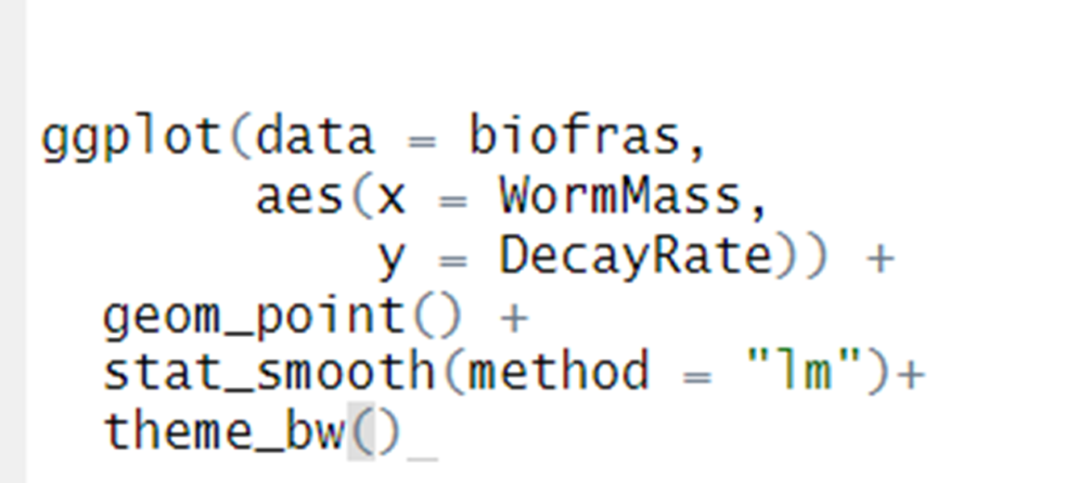
Setting data and basic mapping aesthetics to be used for ALL geoms
Data
Independent variable
Dependent variable
Add layers with “+”
Customize non-data
Geometric (points) and stats (linear model) objects

Slide 8
Building blocks come together
ggplot(iris,
aes(x = Sepal.Width,
y = Sepal.Length))

Slide 9
Building blocks come together
ggplot(iris,
aes(x = Sepal.Width,
y = Sepal.Length))+
geom_point()

Slide 10
Building blocks come together
ggplot(iris,
aes(x = Sepal.Width,
y = Sepal.Length))+
geom_point(aes(color = Species),
size = 4)

Slide 11
Building blocks come together
ggplot(iris,
aes(x = Sepal.Width,
y = Sepal.Length))+
geom_point(aes(color = Species),
size = 4)+
scale_x_continuous(breaks = c(2,3,4))+
ylab("Sepal Length (mm)")+
xlab("Sepal Width (mm)")

Slide 12
Building blocks come together
ggplot(iris,
aes(x = Sepal.Width,
y = Sepal.Length))+
geom_point(aes(color = Species),
size = 4)+
scale_x_continuous(breaks = c(2,3,4))+
ylab("Sepal Length (mm)")+
xlab("Sepal Width (mm)")+
theme(panel.background = element_rect(color = NA, fill = "white"),
axis.line = element_line(color = "black"),
axis.text = element_text(size = 14, color = "black"),
axis.title = element_text(size = 16, color = "black"),
legend.title = element_text(size = 16, color = "black"),
legend.text = element_text(size = 14, color = "black"),
legend.key = element_blank(),
legend.background = element_rect(fill = "white", color = "black"),
legend.position = c(0.84,0.65))

Slide 13
Different types of geoms and stats
Points – geom_point()
Lines – geom_line()
Errorbars – geom_errorbars()
Boxplots – geom_boxplots()
Violin plots – geom_violin()
Maps – geom_map()
Contours – geom_contour()
Density curve – geom_density()
Histogram – geom_histogram()
Text – geom_text()
Bar plots – geom_bar()
Simple Regressions – stat_smooth()
Function creation – stat_function()
Summary info – stat_summary()
2D density plots – stat_density_2d()

Slide 14

Mapping Introduction
A broad overview of some common mapping techniques
Points
Polygons
Should give you a basic understanding of commonly used mapping functions in ggplot

Slide 15
Mapping points with NEON sites

Slide 16
Mapping shapefiles with NEON Ecoregions

Slide 17

Plotting mixed models
This will be a broad, deep dive into mixed models and how to correctly plot them
We’ll cover things that may be unfamiliar, but that’s okay! Not meant to be a comprehensive introduction
If you want to learn more about mixed effects models, check out Ben Bolker’s GLMM FAQs and Alain Zuur’s Mixed Effects Models and Extensions in Ecology with R

Slide 18
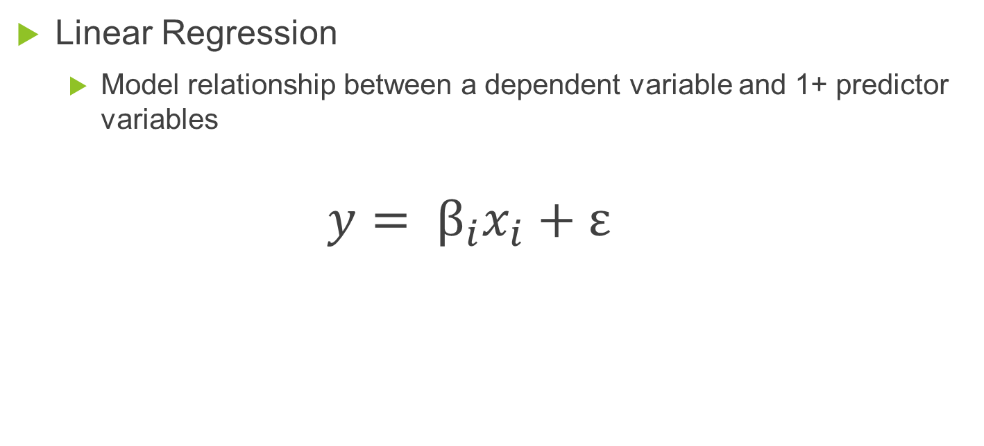
Basic introduction into linear mixed models
Linear Regression
Model relationship between a dependent variable and 1+ predictor variables
$$y= β_{i}x_{i}+ε$$
Residual Error
Independent Variable
Coefficient(s)
Dependent Variable(s)

Slide 19
Basic introduction into linear mixed models
Linear Regression
Model relationship between a dependent variable and 1+ predictor variables
$$y= β_{i}x_{i}+ε$$
Residual Error
Independent Variable
Coefficient(s)
Dependent Variable(s)

Slide 20
Can easily plot SIMPLE linear regressions with stat_smooth(method = “lm”)

Slide 21
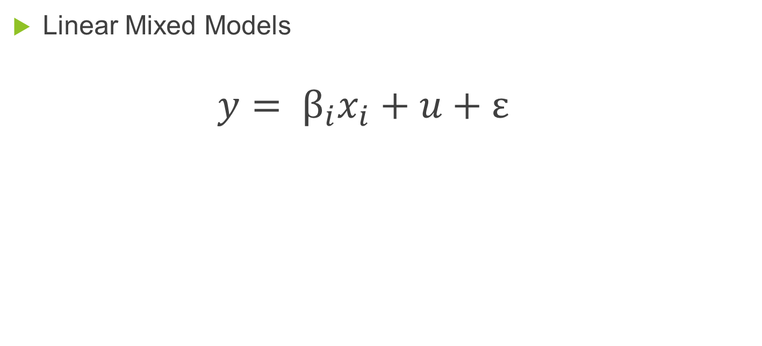
Mixed models are a bit more complex
Linear Mixed Models
$$y= β_{i}x_{i}+u+ε$$
Random term
Residual Error
Independent Variable
Coefficient(s)
Dependent Variable(s)

Slide 22
Should I treat factor xxx as fixed or random?
One modeler’s random effect is another modeler’s fixed effect.
Sometimes the answer is easy and based solely on the design of your experiment. Other times it isn’t easy.
There is no clear cut answer.
If you suspect that some of the error of your data within groups is not independent (i.e. samples from the same site); you should use include this grouping variable as a random term
Specifying random structure of a mixed model: https://bbolker.github.io/mixedmodels-misc/glmmFAQ.html#model-specification

Slide 23
Fitting mixed models in R with lme4
lmer( response ~ fixed_predictor + (1 | random_term), data)
Random intercepts model; fixed_predictor slope is constant across levels of random_term
lmer( response ~ fixed_predictor + (fixed_predictor | random_term), data)
Random slopes and intercepts model; fixed_predictor slope varies across levels of random_term
Fixed effect is the population level mean effect

Slide 24
Different “random” effects change your model
Random Intercept (1 | Subject)
Random Intercept & Slope (Days | Subject)

Slide 25

Correctly plotting mixed models (and multiple regression models)
ggeffects package
Create Tidy data frames of marginal effects for ggplot
Support for a TON of model-objects
bamlss, bayesx, betabin, betareg, bglmer, blmer, bracl, brglm, brmsfit, brmultinom, cgam, cgamm, clm, clm2, clmm, coxph, fixest, gam (mgcv), Gam (gam), gamlss, gamm, gamm4, gee, geeglm, glm, glm.nb, glmer, glmer.nb, glmmTMB, glmmPQL, glmrob, glmRob, glmx, gls, hurdle, ivreg, lm, lm_robust, lme, lmer, lmrob, lmRob, logistf, lrm, MixMod, MCMCglmm, mixor, multinom, negbin, nlmer, ols, plm, polr, rlm, rlmer, rq, rqss, stanreg, survreg, svyglm, svyglm.nb, tobit, truncreg, vgam, wbm, zeroinfl, zerotrunc

Slide 26
ggpredict v. ggeffect v. ggemmeans
Functions differ in how factors are held constant when looking at marginal plots
ggpredict() uses the reference level
ggeffect() and ggemmeans() compute a kind of "average" value, which represents the proportions of each factor's category;
Difference between these is how the effects are fit (Effect v emmeans packages)
To hold factors at a constant user-defined level, use condition in ggemmeans()
For models without categorical predictors, ggpredict(), ggeffect(), and ggemmeans()are identical

Slide 27
When to use type = “fe” and type = “re”
Whether to account for the uncertainty of random effects can be set with the type argument.
When type = "fe", predictions are on the population-level and do not account for the random effect variances.
Confidence intervals for the predicted values.
When type = "re", predictions are still on the population-level, but random effect variances are taken into account.
Termed “Prediction intervals” and become MUCH larger than confidence intervals. NOT recommended if you have a lot of variance in your random term.
If you have random slopes in your model AND want to look at these random slopes, use type = "re" with ggpredict
Notes:
More technically speaking, type = "re" accounts for the uncertainty of the fixed effects conditional on the estimates of the random-effect variances and conditional modes (BLUPs).

Slide 28
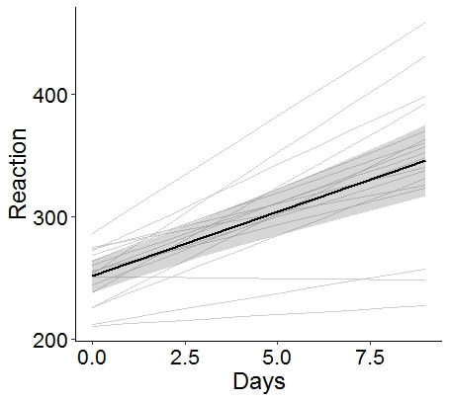
When to use type = “fe” and type = “re”
Random slopes
If you have random slopes in your model AND want to look at these random slopes, use
ggpredict(model,
terms = c(“FIXED”,”RANDOM”)
type = “re”)
Fixed effect &
95% confidence interval
Notes:
More technically speaking, type = "re" accounts for the uncertainty of the fixed effects conditional on the estimates of the random-effect variances and conditional modes (BLUPs).

Slide 29
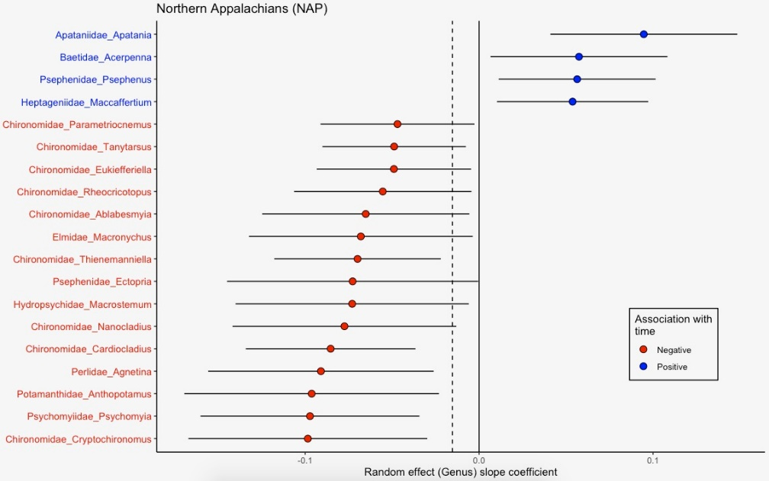
Forest Plot of Random Terms
To show variation across your random terms (slope or intercept), but don’t want to have multiple lines on the same figure
Solid vertical line is a zero slope (flat line)
Points are the random term (Genus) deviance from the population mean for the slope
Figure credit to Devin Jones
Notes:
Forest plots also help to inform which levels of your random term are different from 0 or your population mean estimate (fixed effect); if the errorbars don’t overlap 0, we can infer that the slope of the line is significantly different from 0.

Slide 30
Customizing figures
ggplot allows users a multitude of customization options
Axis scaling and transformations
Colors
Title/label font, text size, etc.

Slide 31
Axes customization
scale_y_continuous() allows you to set the limits, breaks, and labels of your y axis (works for x axis too; scale_x_continuous()
Transform axes
scale_y_continuous(trans = “log”) for natural log transformation
scale_y_log10() for log10 transformation
breaks = c() and labels = c() allow you to set breaks and make new labels for your axes
Notes:
ggplot makes it easy to customize axis scales!

Slide 32
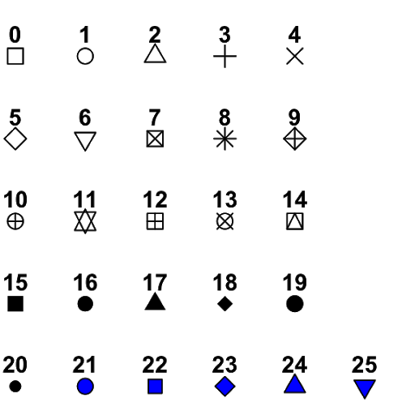
Shapes!
Change point shapes with geom_point(shape = ) OR geom_point(aes(shape = VARIABLE)) with scale_shape_manual(values = c( , ))
Shape codes 0-20 only work with the “color” aesthetic
Shape codes 21-25 work with “color” and “fill” aesthetics

Slide 33

Working with Color – Categorical Variables
NOTE: Replace * with fill or color
Manually select colors
scale_*_manual()
values = c(); the name or hex values of the colors; length must be equal to the number of categories in your dataset
https://coolors.co/
Using built-in palettes
scale_*_brewer()
palette = “”; a variety of built-in palettes exist; http://colorbrewer2.org/
scale_*_viridis()
discrete = TRUE; limited palettes: colorful, uniform, robust of colorblind, and pretty
library(viridis)

Slide 34
Working with Color – Continuous Variables
NOTE: Replace * with fill or color
Manually setting a palette
scale_*_gradient(); gradient from “low” color to “high” color
scale_*_gradient2(); gradient from “low” to “mid” to “high”; allows customization for midpoint
http://colorbrewer2.org/
Using built-in palettes
scale_*_brewer()
palette = “”; a variety of built-in palettes exist; http://colorbrewer2.org/
scale_*_viridis()
option = “”; limited palettes: colorful, uniform, robust of colorblind, and pretty
library(viridis)

Slide 35
Overcoming overlapping points
Option 1: Change the “alpha” to a lower level (0.1-0.5)
Changes the transparency of geoms
Helpful when there are quite a few overlapping points on your plot
Option 2: Jitter your points!
geom_jitter is the default in ggplot; ALL points are jittered
geom_beeswarm or geom_quasirandom (in ggbeeswarm) jitters points only when overlap in points is present and does so in a way that matches the distribution of your data (similar to histogram, density plot, or violin plot)

Slide 36
Overcoming overlapping points
geom_jitter(height=0)
geom_quasirandom()
Notes:
Real data from my dissertation: sampled ants from the forest floor across 5 sites. Y axis is the number of ants collected per sample; x axis is categorical of each site.

Slide 37
Coordinates
coord_flip() flips the x and y axes
coord_cartesian() allows you to zoom in on a specific area of your figure using xlim and ylim
Notes:
ggplot makes it easy to customize axis scales!

Slide 38
Custom Axis Title with italics, ^{superscripts}, _{subscripts}, AND multiple lines
P. leucopus density
(ind. / km²)
expression(atop(italic("P. leucopus")~"density", "(ind. / km"^2*")"))
expression(atop(italic("P. leucopus")~"density", "(ind. / km“[2]*")"))
Within “expression()”
~ indicates a space
* indicates NO space
Superscript
TWO
LINES
Use “~” to stay on top line, when using atop()
Use “,” to start new line, when using atop()
ITALICIZED
P. leucopus density
(ind. / km₂)
Subscript

Slide 39

Legends of ggplot2
Position on plot
Relative coordinates: theme(legend.position = c(0.1, 0.5))
Bottom of plot: theme(legend.position = “bottom”)
Removing the grey box around keys
theme(legend.key = element_rect(fill=NA,color=NA))
Change the number of rows in a legend
guides(color = guide_legend(nrow = 8))
Change “color” to whatever your legend is based upon

Slide 40
Faceting - split your data by 1+ variables and plot the subsets of data together
facet_wrap() and facet_grid()
. ~ VARIABLE
scales argument allows you to have “fixed” or “free” axis scales
labeller argument allows for some flexibility in labelling facets
Notes:
Differences between facet_wrap and facet_grid are minimal; facet_grid gives you x and y faceting; facet_wrap works a bit better when you have more levels in a variable: wraps the facets in more than 1 row.

Slide 41
Saving high quality figures
Use the FULL path to make sure you know exactly where you figure is stored
ggsave(filename = “C://Users/Michael/Documents/Figure1.tiff”,
plot = “AwesomePlot”,
dpi = 600)
Tiff/tif files offer the highest resolution possible; though file size is large
Name of your ggplot object
High dpi =
higher resolution =
large file size
Notes:
Most journals require 600 dpi for final figures.

Slide 42
Make your own theme! – Just change any of these theme functions
my_theme() <- function(){
theme(
panel.background = element_rect(fill=NA),
panel.grid = element_blank(),
panel.border = element_blank(),
axis.line = element_line(color="black"),
legend.title = element_text(size=18, color="black"),
legend.text = element_text(size=16, color="black"),
legend.key = element_rect(fill=NA, color=NA),
axis.text = element_text(size=16, color="black"),
axis.title = element_text(size=18, color="black")
)
}

